Slide 1

Practice of Deep Learning
Bonus 3 – Implementing Advanced Concepts in PyTorch
Matthieu De Mari

Slide 2
Introduction (Week 3)
How to use PyTorch to implement advanced optimizers?
How to use PyTorch to implement advanced initializers?
How to use PyTorch to implement regularization?
What are the Dataset and Dataloader objects in PyTorch?
How to implement a custom Dataloader and Dataset object in PyTorch?

Slide 3
Using advanced optimizers (Adam, etc.)
Our next step is logically to replace our vanilla gradient descent with some more advanced optimizers, e.g. Adam, AdaGrad, RMSProp, etc.
Again, we will be relying on PyTorch as much as possible.
Feel free to have a look at all the available built-in optimizers, available in PyTorch, here: https://pytorch.org/docs/stable/optim.html
Let us now demonstrate how to use them in our Neural Network!

Slide 4
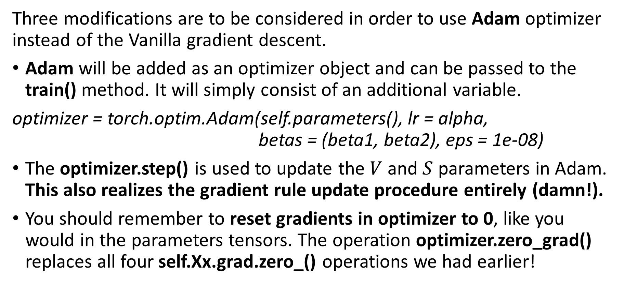
Using advanced optimizers (Adam, etc.)
Three modifications are to be considered in order to use Adam optimizer instead of the Vanilla gradient descent.
Adam will be added as an optimizer object and can be passed to the train() method. It will simply consist of an additional variable.
optimizer = torch.optim.Adam(self.parameters(), lr = alpha,
betas = (beta1, beta2), eps = 1e-08)
The optimizer.step() is used to update the $V$ and $S$ parameters in Adam. This also realizes the gradient rule update procedure entirely (damn!).
You should remember to reset gradients in optimizer to 0, like you would in the parameters tensors. The operation optimizer.zero_grad() replaces all four self.Xx.grad.zero_() operations we had earlier!

Slide 5
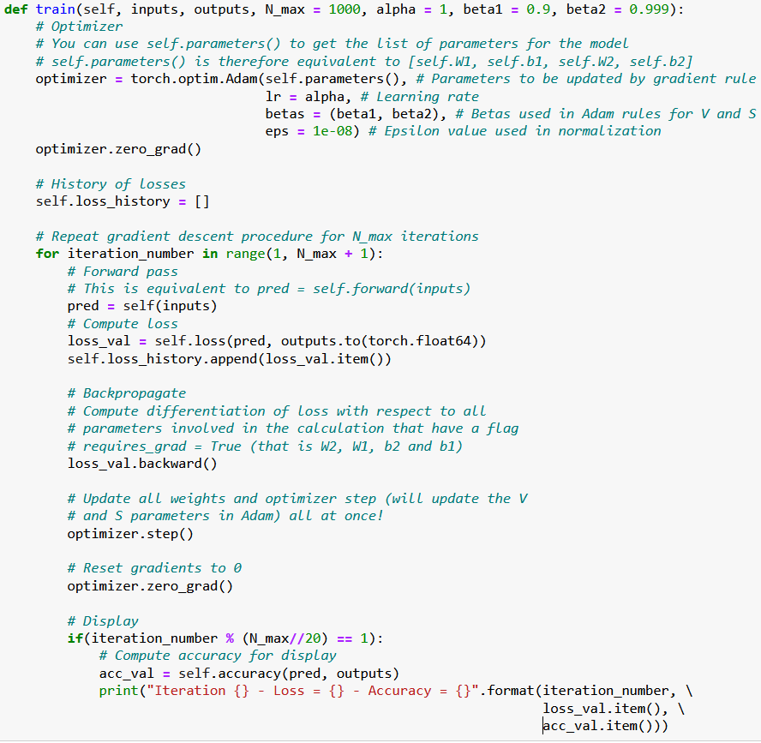

Slide 6
Using advanced optimizers (Adam, etc.)
Feel free to also have a look at the implementation of these optimizers. (You should be able to recognize some concepts from Week 2!)
These optimizers come with a few more features that might be worth exploring if you are curious (but we will consider them out-of-scope)!
https://pytorch.org/docs/stable/generated/torch.optim.Adam.html#torch.optim.Adam
Note: implementing your own optimizer is generally a “bad” idea (takes lots of work!), but feel free to look at source codes to see what it takes!
https://pytorch.org/docs/stable/_modules/torch/optim/adam.html#Adam

Slide 7
Implementing a stochastic mini-batch GD
We can also define a Stochastic Mini-Batches Gradient Descent procedure. This is typically done with two steps.
Create a Dataset and a Dataloader using the inputs and outputs provided in the train().
(We will learn more about these Dataset and Dataloader objects in the next notebook and lecture. For now, just consider that it allows to conveniently zip the data in an object that is able to shuffle and draw random mini-batches of data for us.)
2. Loop over the mini-batches of data, instead of using the entire inputs/outputs at once, like in (full) batch gradient descent.

Slide 8
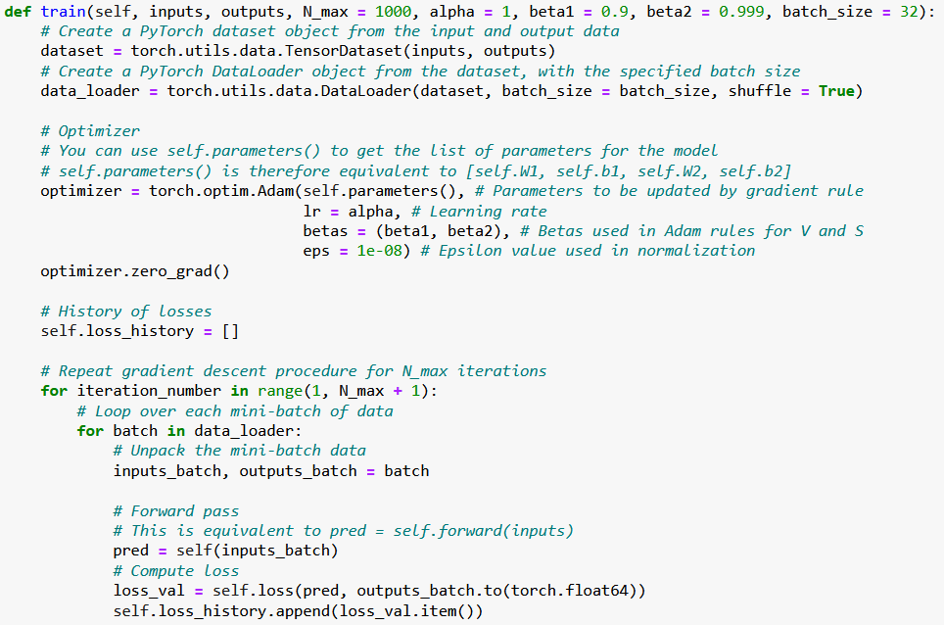

Slide 9
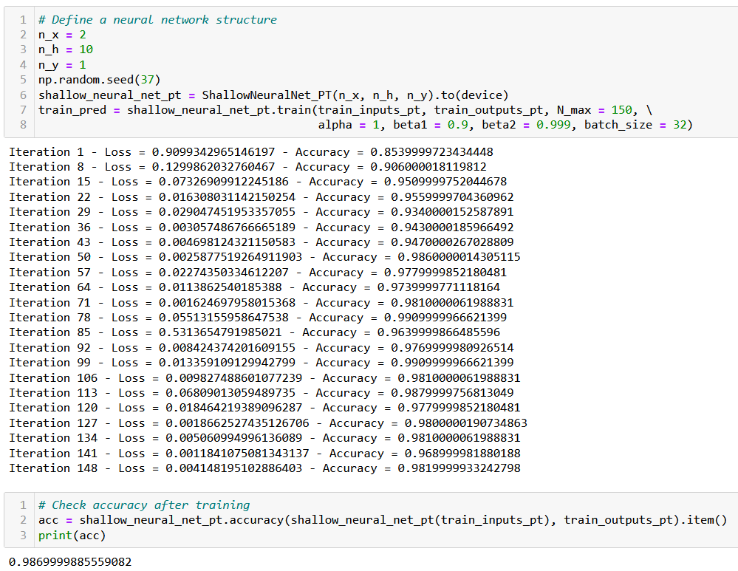

Slide 10
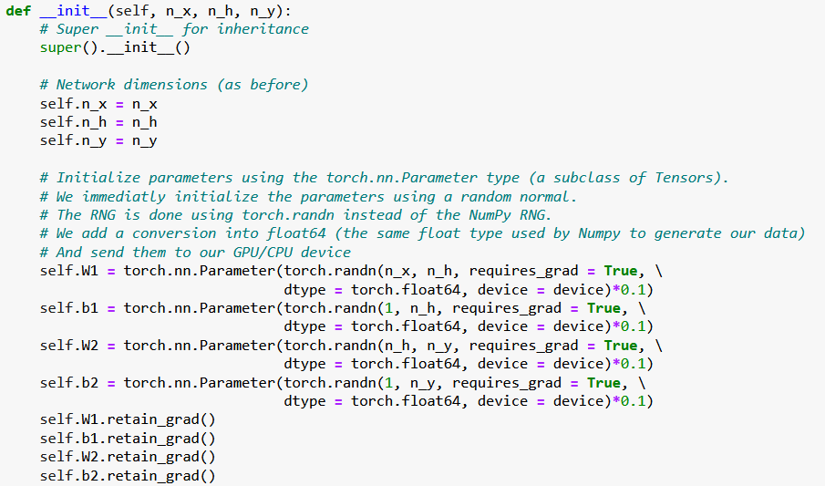
Better initializers in PyTorch
This part is a bit tedious and relies on our own manual implementation of a random normal initializer.
Need to replace these RNG with built-in PyTorch initializers!

Slide 11
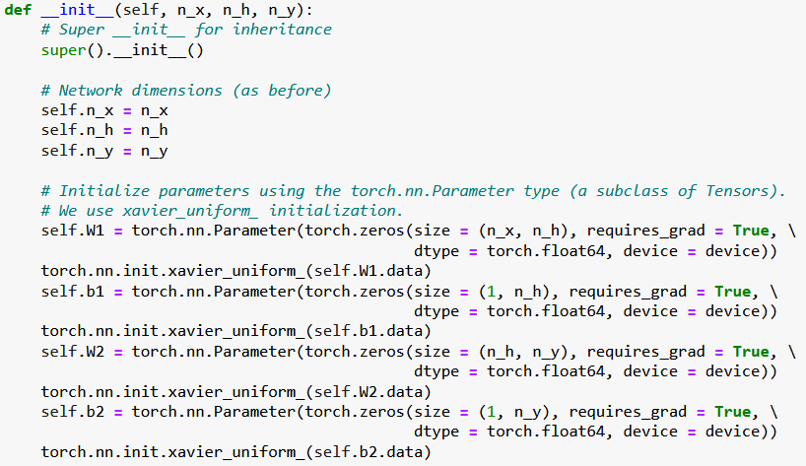
Better initializers in PyTorch
Fixed!
Feel free to have a look at this for additional initializers in PyTorch.
https://pytorch.org/cppdocs/api/file_torch_csrc_api_include_torch_nn_init.h.html#file-torch-csrc-api-include-torch-nn-init-h

Slide 12
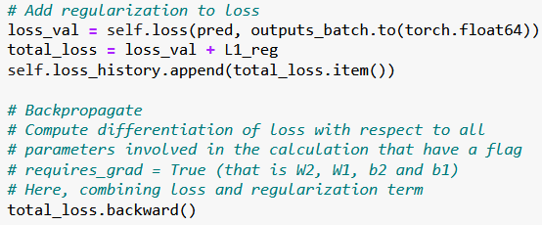

Adding a regularization to our loss
We have also seen during Ridge Regression (on Week 1) that it is sometimes beneficial to add a regularization term to our loss functions.
Our first step would be to simply compute our regularization term by using the PyTorch functions, for instance the L1 loss.
We would then simply add it to the loss before backpropagating.

